Slide 1
The Perspectives on NCYU
Office of International Affairs
National Chiayi University, Taiwan

Slide 2
Taiwan is an island with 36,000 square kilometers of total land area and 23 millions of population.

Slide 3
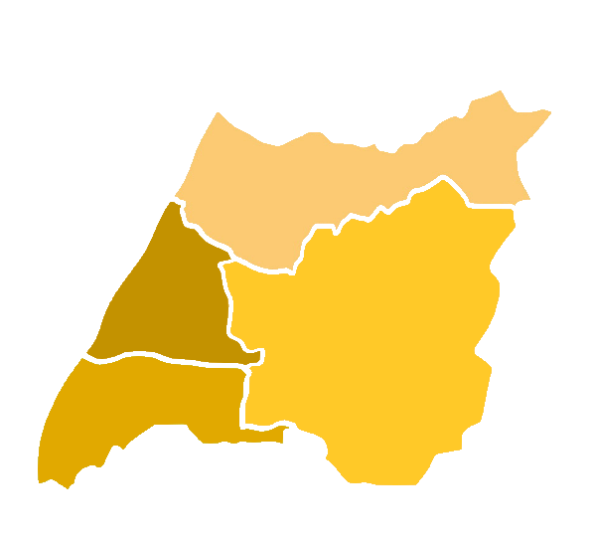
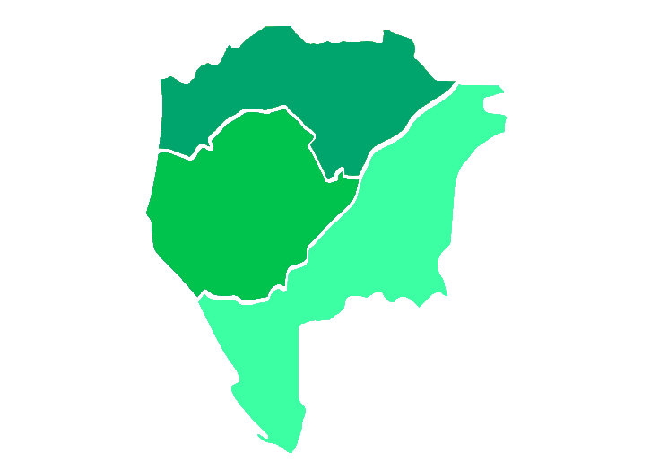
About Chiayi
Northern Taiwan
Area: 60.0256 km2 (23.1760 sq mi)
Population: 270,000
Climate: Moderate
Famous Local Cuisine: Turkey Rice
Middle of Taiwan
Eastern Taiwan
Southern Taiwan

Slide 4
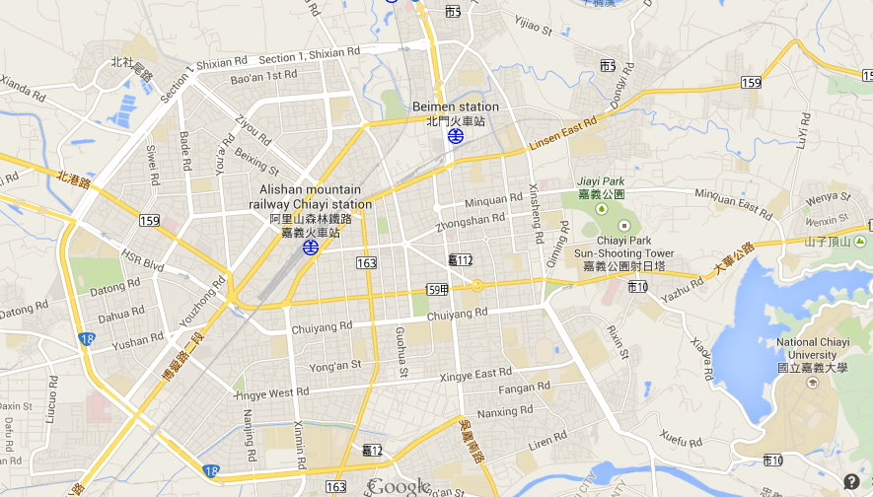
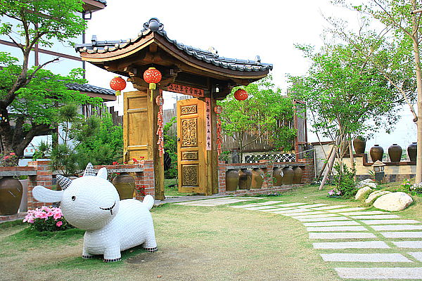
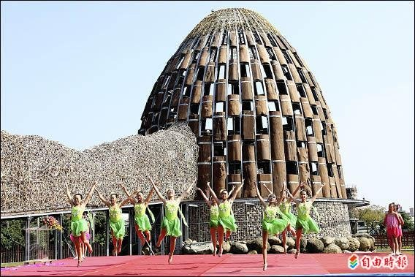
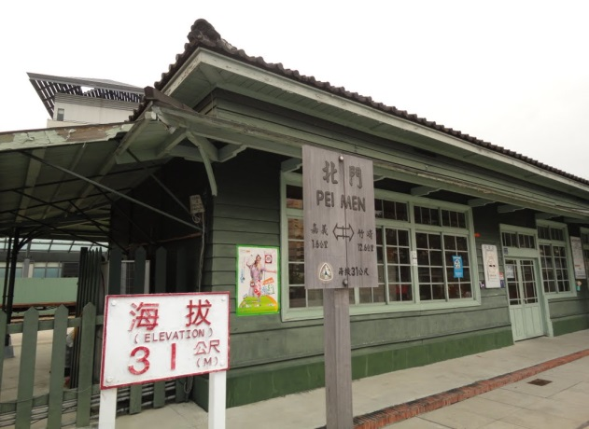
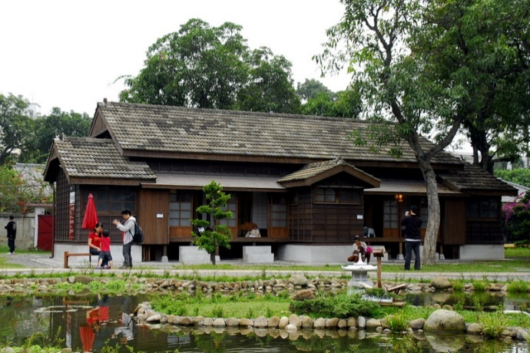
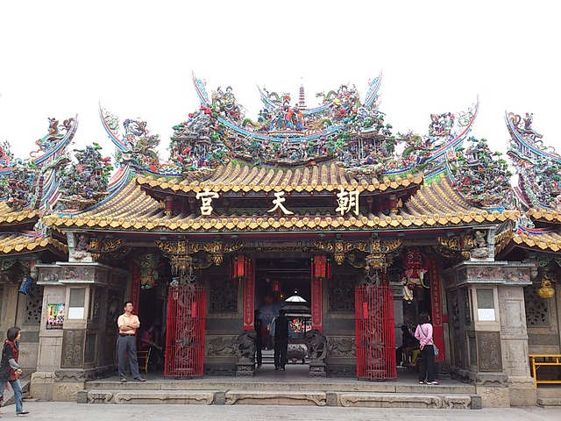
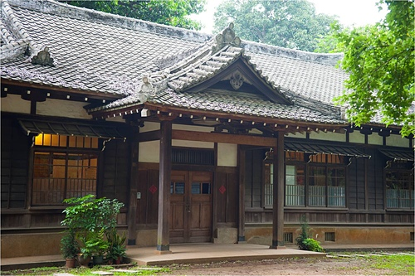
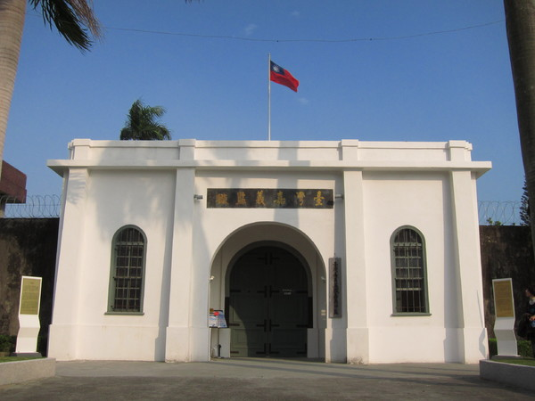
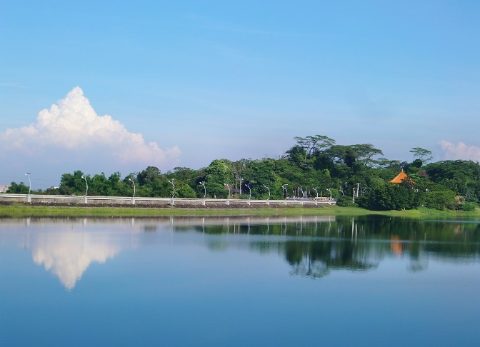
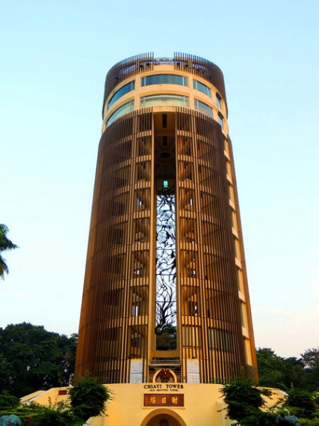
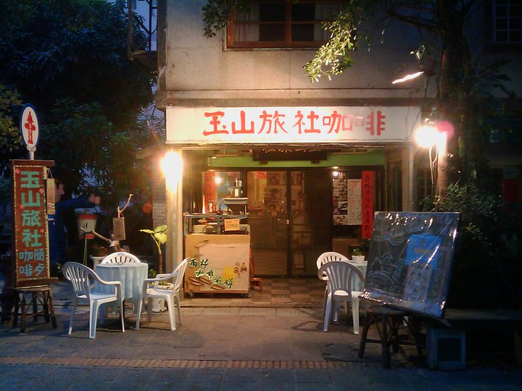
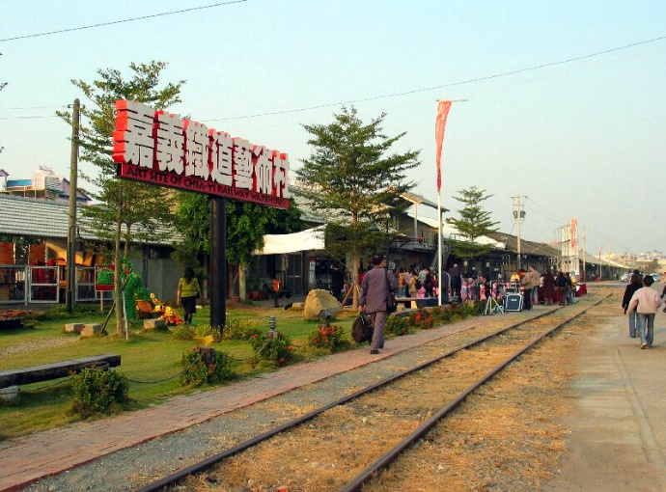
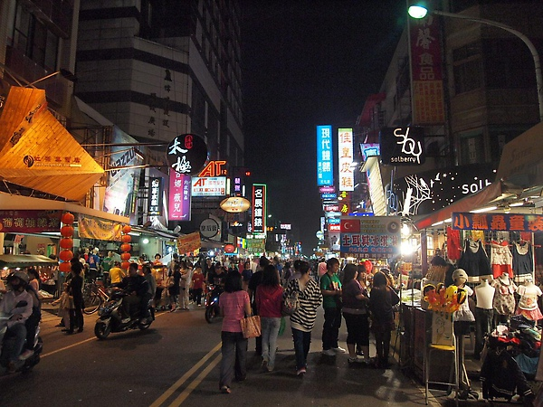
Chiayi City is about 270,000 population. You will find its’ historical depth and marvelous stories while you are getting familiar with this city. It is easy to find the historical traces from buildings and museums. All left for you to discover. The city is also the entrance to Mount A-Li which lead to the breath-taking sceneries you would dream to see.

Slide 5
Alishan National Scenic Area
This area includes, among other things, mountain wilderness, waterfalls, the Alishan Forest Railway. The area is well known for its sunrises, and on a suitable morning one can observe the sun come up on a sea of clouds.
Notes:
http://www.youtube.com/watch?v=8HWb0NVHthA

Slide 6
National Chiayi University (NCYU)
A comprehensive university was first established in 1919.
Located at the largest agro-food production area in Taiwan and under the well-known Mount A-Li, also known as Alishan.

Slide 7
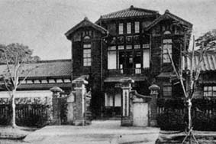
Brief History of NCYU
NCTC National Chiayi Institute of Technology
NCIC National Chiayi Teachers College
1919 Chiayi Agriculture and Forestry Public School
1945 Taiwan Provincial Chiayi Agri-Vocational School
1965 Taiwan Provincial Chiayi Junior College of Agriculture
1981 National college directly funded by the Ministry of
Education
1997 National Chiayi Institute of Technology
Taiwan Provincial Chiayi Normal School
1966 Taiwan Provincial Chiayi Junior Teachers College
1987 Taiwan Provincial Chiayi Teachers College
1991 National Chiayi Teachers College
2000 National Chiayi University
NCYU is one of the oldest and largest universities
in the southern part of Taiwan.

Slide 8
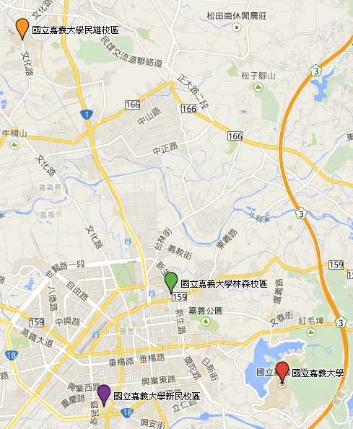
Min-Hsiung Campus
- Teachers College
- College of Humanities and Arts
Hsinming Campus
- College of Management
Lantan Campus
- College of Science and Engineering
- College of Agriculture
- College of Life Sciences
Linsen Campus
- Teachers College Division

Slide 9
NCYU Facts
7 Colleges
Student Enrollment
12,269 students
Faculty Member
466 members
Programs
39 undergraduate
38 master
16 in-service master
7 Ph. D
Campus Area
150 Hectare

Slide 10
Teachers College
The Teachers College seeks for academic excellence, diversity and innovation in the fields of teacher preparation and educational research.

Slide 11
Department of …
Counseling
Physical Education, Health & Recreation
Early Childhood Education
Special Education
Education
E-Learning Design and Management
Teachers College
Graduate Institute of Mathematics and Science Education
Graduate School of Educational Administration and Policy Development
Global Master Program of Teaching Profession
Notes:
Physical Education, Health & Recreation （with Graduate Institute)

Slide 12
Department of
Center of Humanities and Arts
Taiwan Culture Research Center
Graduate Institute of Music and Performing Arts
Chinese Literature
Foreign Languages
Applied History
Music
Visual Arts
The College integrates humanities and arts. It is committed to teaching, research, application and development of both theory and activity.
College of Humanities and Arts
Notes:
Physical Education, Health & Recreation （with Graduate Institute)

Slide 13
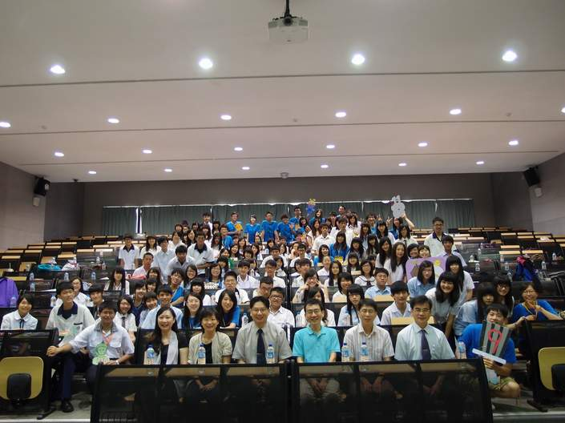
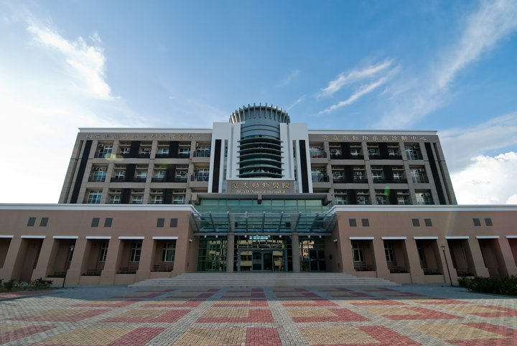
College of Management
The educational objectives of the College of Management are to develop students’ potential in management , and to guide them to be managers in their own right, and to make contributions to our society by fully using their aptitudes and abilities.

Slide 14
Department of…
Business Administration
Banking and Finance
Applied Economics
Bio-industry and Agribusiness Administration
Management Information Systems
Marketing and Logistics/Transportation
Programs
Graduate Institute of Recreation, Tourism, and Hospitality Management
Global Master Program of Tourism and Management
EMBA Program
The College of Management are to develop students’ potential in management , and to guide them to be managers in their own right, and to make contributions to our society by fully using their aptitudes and abilities.
College of Management
Notes:
Physical Education, Health & Recreation （with Graduate Institute)

Slide 15
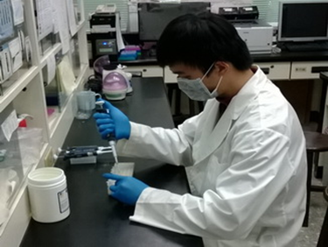
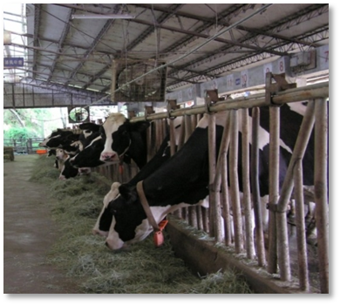
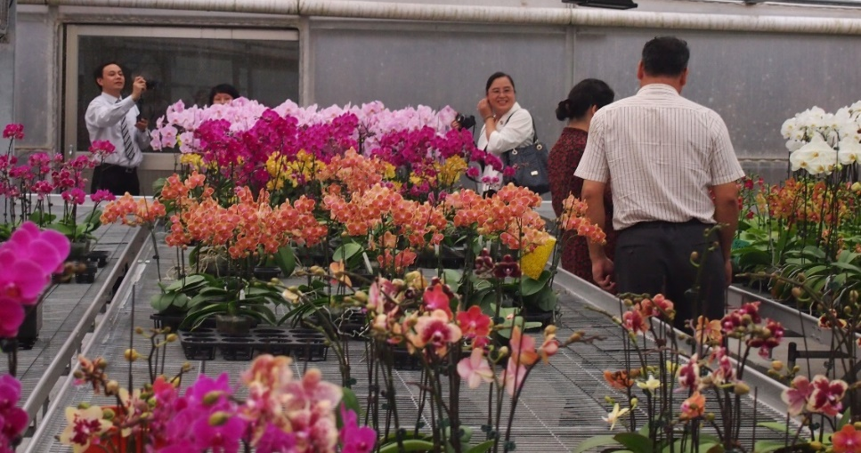
College of Agriculture
The College of Agriculture aims to pursue modern agricultural technology, to develop intensive agriculture, and to promote sustainable agriculture, life, and ecological systems. The College is devoted to the advancement of agricultural theories, practices, research, and extension services.

Slide 16
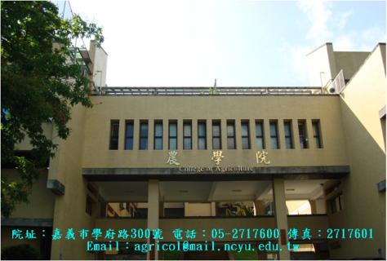
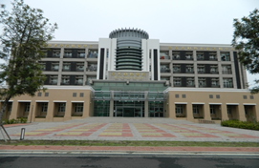
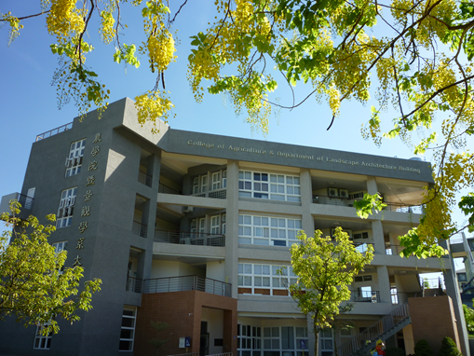
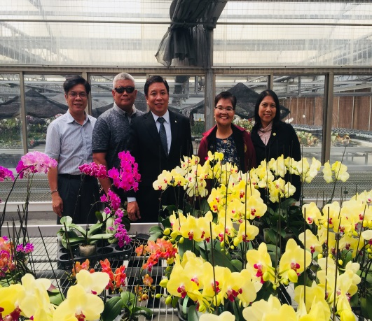
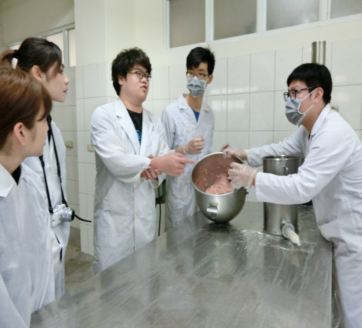
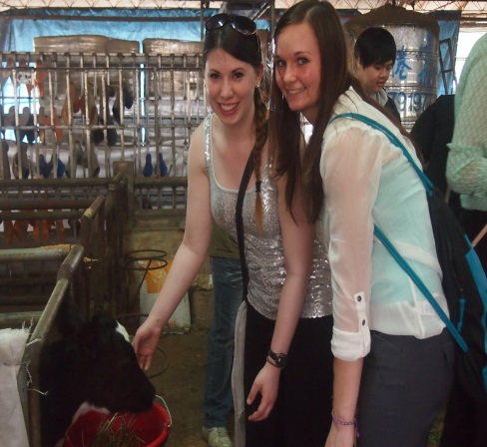
Forest Products Science & Furniture Engineering
Agronomy
Horticultural Science
Forestry
Animal Science
Bio Agricultural Science
Landscape Architecture
Plant Medicine
College of Agriculture
Notes:
Physical Education, Health & Recreation （with Graduate Institute)

Slide 17
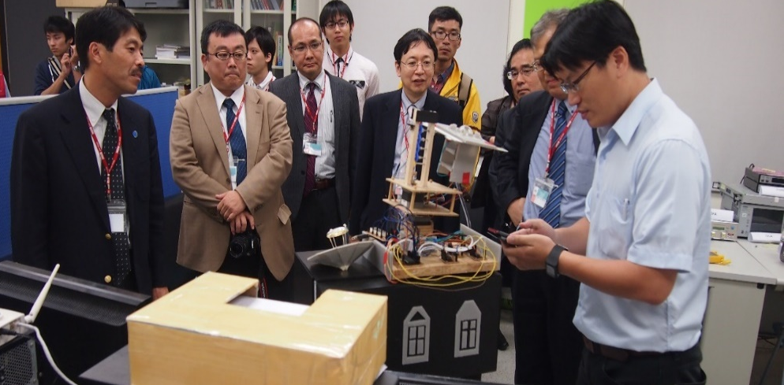
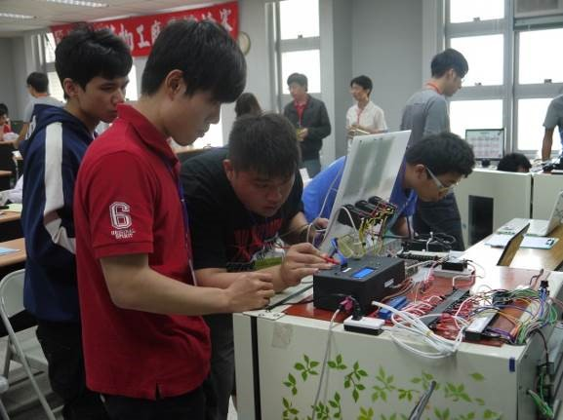
College of Science and Engineering
The College of Science and Engineering is an incubator of engineering and technology professionals where students are trained in cutting edge scientific knowledge and technology.

Slide 18
Electrophysics
Applied Chemistry
Applied Mathematics
Biomechatronic Engineering
Civil and Water Resources Engineering
Computer Science and Information Engineering
Electrical Engineering
Mechanical and Energy Engineering
College of Science and Engineering
Notes:
Physical Education, Health & Recreation （with Graduate Institute)

Slide 19
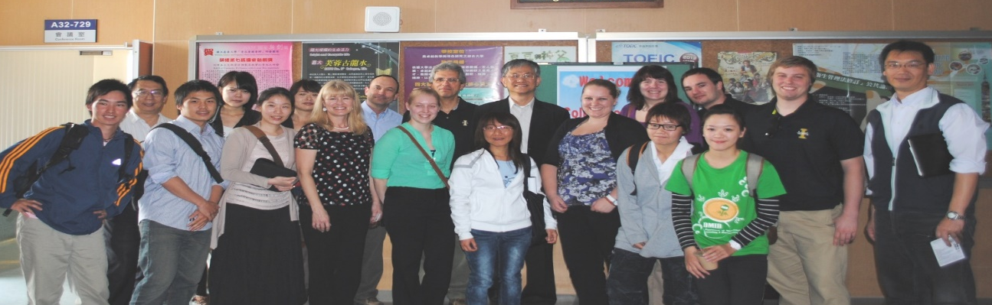
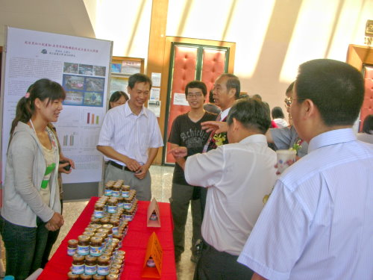
College of Life Sciences
The College seeks a harmonious relationship between scientific advancement and diversified biological development through engaging in cutting-edge research based on innovative biotechnology and modernized educational concepts. The ultimate goal of the College is to pursue both extraordinary practical and academic research abilities.

Slide 20
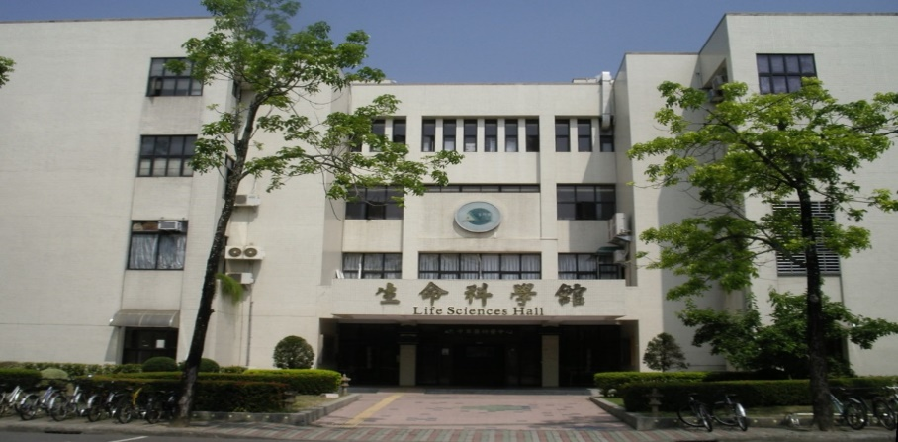
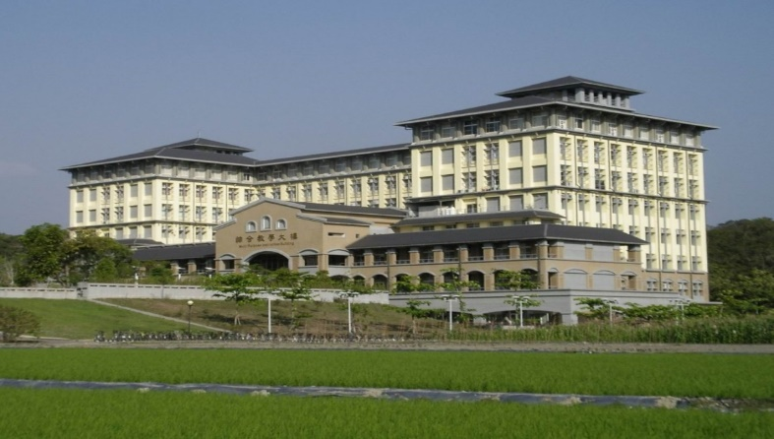
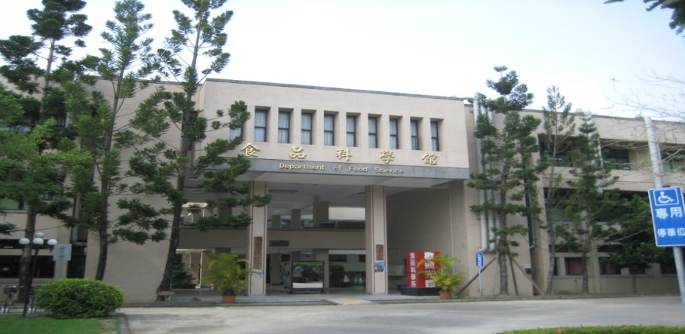
College of Life Sciences
Department of Food Science
Department of Aquatic Biosciences
Department of Biological Resources
Department of Biochemical Science and Technology
Department of Microbiology, Immunology and Biopharmaceuticals
Global Master Program of Life Sciences

Slide 21
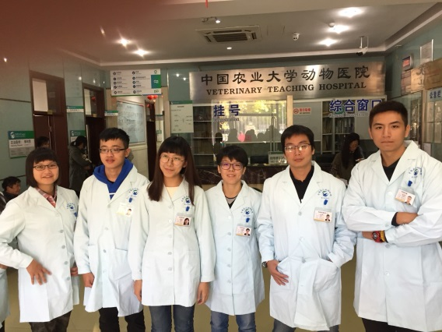
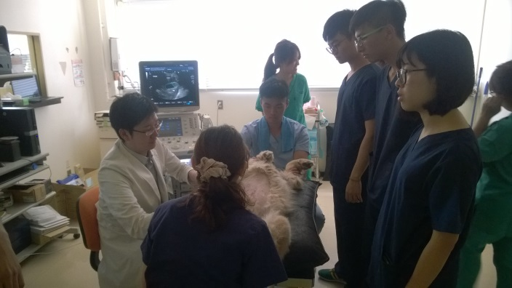
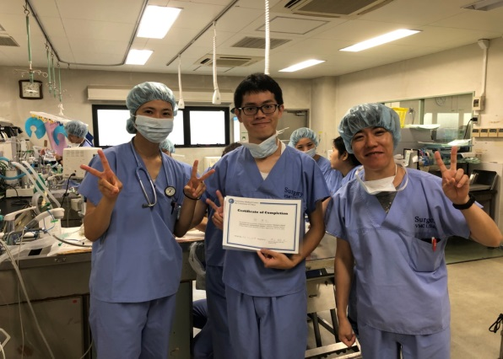
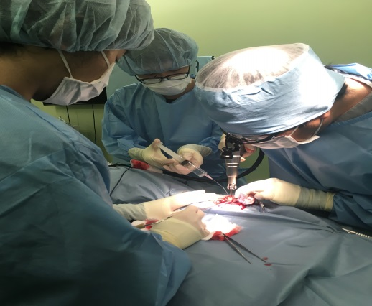
College of Veterinary Medicine
The College of Veterinary Medicine established in 2016 offers bachelor master degree programs. The College also comprises Animal Disease Diagnostic Center and Veterinary Teaching Hospital. The mission of the College is to educate veterinary and graduate students to promote the health and well-being of people and animals. The College provides the knowledge and skills of diagnosis, treatment, prevention, and control of animal disease.

Slide 22
2021 Statistics-geographical Distribution
*113 Partner Universities
*334 International Students (including Foreign Students, Chinese overseas students, and Mainland China Students)
ASIA | No.
Partner University | 83
International Student | 327
AMERICA | No.
Partner University | 17
International Student | 3
Oceania | No.
Partner University | 4
EUROPE | No.
Partner University | 9
International Student | 1
AFRICA | No.
International Student | 3

Slide 23
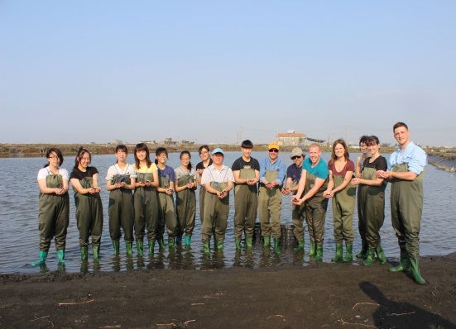
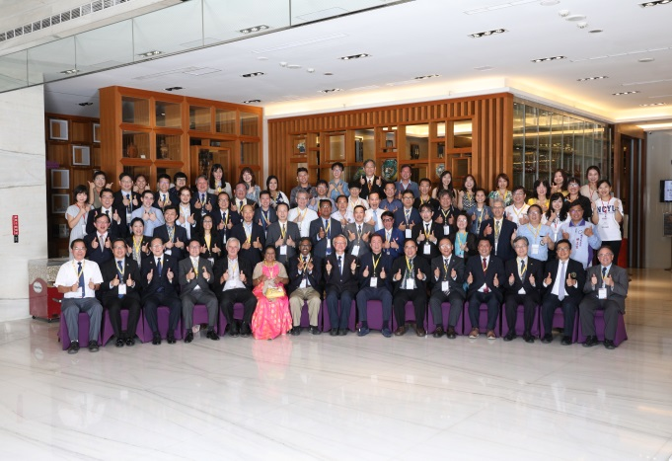
Cooperation programs with international partners
Dual degree programs
Faculty exchange
Student exchange
Joint workshops
Academic visit
Student Internship
Chinese Language and Culture Programs

Slide 24
Thanks for your attention

